Slide 1
Presented by [insert class name]

Slide 4
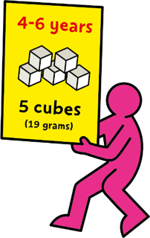
Notes:
1 cube = 4g sugar
Remember that fresh fruit and vegetables, plain milks and plain natural yoghurts all contain ‘intrinsic sugars’, which we don’t need to worry about. 5 A Day guidance specifies that dried fruit and fruit juice, vegetable juice and smoothies are not suitable to be consumed between meals due to dental concerns.
For more information, see the EatWell guide: https://campaignresources.phe.gov.uk/schools/resources/eatwell-guide

Slide 5
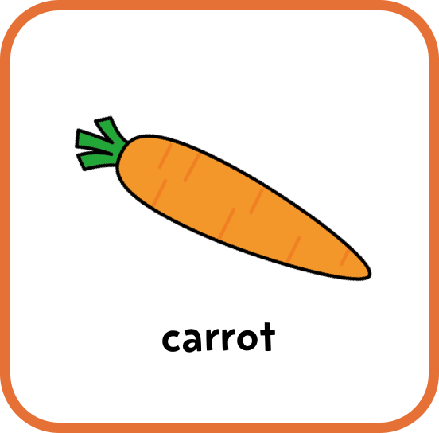
Notes:
Encourage audience participation. Ask pupils to call out what each image shows. Then choose a volunteer or ask for a show of hands to see which option the pupils think is correct.
Remember that fresh fruit and vegetables, plain milks and plain natural yoghurts all contain ‘intrinsic sugars’, which we don’t need to worry about. 5 A Day guidance specifies that dried fruit and fruit juice, vegetable juice and smoothies are not suitable to be consumed between meals due to dental concerns.
For more information, see the EatWell guide: https://campaignresources.phe.gov.uk/schools/resources/eatwell-guide

Slide 7
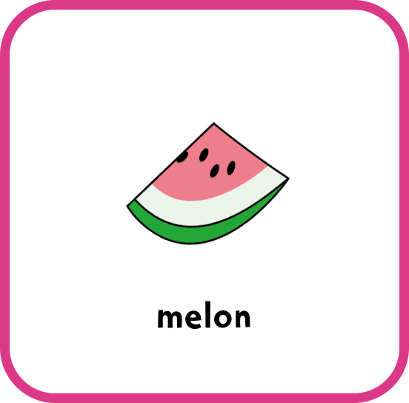
Notes:
Encourage audience participation. Ask pupils to call out what each image shows. Then choose a volunteer or ask for a show of hands to see which option the pupils think is correct.
Remember that fresh fruit and vegetables, plain milks and plain natural yoghurts all contain ‘intrinsic sugars’, which we don’t need to worry about. 5 A Day guidance specifies that dried fruit and fruit juice, vegetable juice and smoothies are not suitable to be consumed between meals due to dental concerns.
For more information, see the EatWell guide: https://campaignresources.phe.gov.uk/schools/resources/eatwell-guide

Slide 9
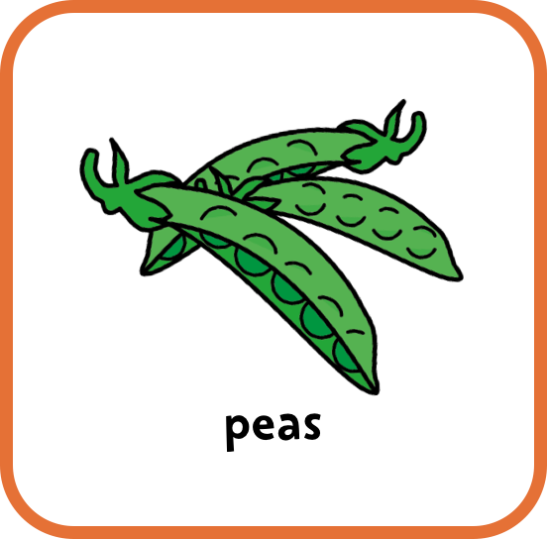
Notes:
Encourage audience participation. Ask pupils to call out what each image shows. Then choose a volunteer or ask for a show of hands to see which option the pupils think is correct.
Remember that fresh fruit and vegetables, plain milks and plain natural yoghurts all contain ‘intrinsic sugars’, which we don’t need to worry about. 5 A Day guidance specifies that dried fruit and fruit juice, vegetable juice and smoothies are not suitable to be consumed between meals due to dental concerns.
For more information, see the EatWell guide: https://campaignresources.phe.gov.uk/schools/resources/eatwell-guide

Slide 11
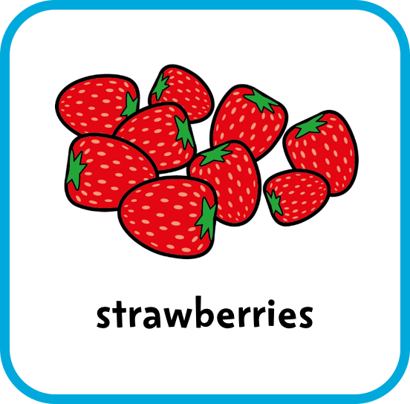
Notes:
Encourage audience participation. Ask pupils to call out what each image shows. Then choose a volunteer or ask for a show of hands to see which option the pupils think is correct.
Remember that fresh fruit and vegetables, plain milks and plain natural yoghurts all contain ‘intrinsic sugars’, which we don’t need to worry about. 5 A Day guidance specifies that dried fruit and fruit juice, vegetable juice and smoothies are not suitable to be consumed between meals due to dental concerns.
For more information, see the EatWell guide: https://campaignresources.phe.gov.uk/schools/resources/eatwell-guide

Slide 13
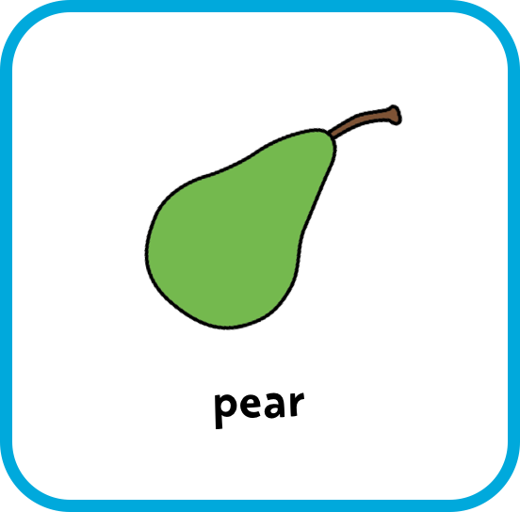
Notes:
Answer: pear.
Fruit and veg are a great choice for snacks. Biscuits can contain lots of added sugar and saturated fat so we shouldn’t eat them often.
Encourage audience participation. Ask pupils to call out what each image shows. Then choose a volunteer or ask for a show of hands to see which option the pupils think is correct.
Remember that fresh fruit and vegetables, plain milks and plain natural yoghurts all contain ‘intrinsic sugars’, which we don’t need to worry about. 5 A Day guidance specifies that dried fruit and fruit juice, vegetable juice and smoothies are not suitable to be consumed between meals due to dental concerns.
For more information, see the EatWell guide: https://campaignresources.phe.gov.uk/schools/resources/eatwell-guide

Slide 15
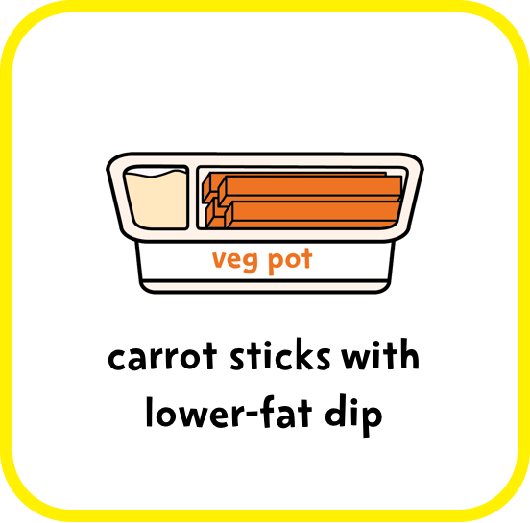
Notes:
Answer: carrot sticks with lower-fat dip.
Fruit and veg are a great choice for snacks. Muffins and pastries can contain lots of added sugar and saturated fat so we shouldn’t eat them often.
Encourage audience participation. Ask pupils to call out what each image shows. Then choose a volunteer or ask for a show of hands to see which option the pupils think is correct.
Remember that fresh fruit and vegetables, plain milks and plain natural yoghurts all contain ‘intrinsic sugars’, which we don’t need to worry about. 5 A Day guidance specifies that dried fruit and fruit juice, vegetable juice and smoothies are not suitable to be consumed between meals due to dental concerns.
For more information, see the EatWell guide: https://campaignresources.phe.gov.uk/schools/resources/eatwell-guide

Slide 17
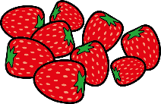
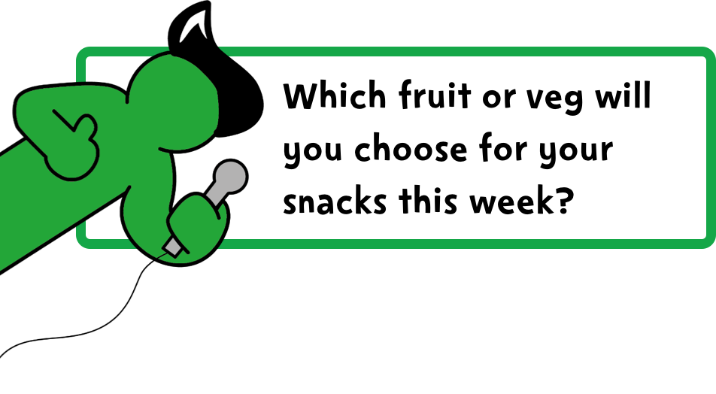

Slide 18
